Slide 1

Department of Information Technology
A.P. Shah Institute of Technology
G.B.Road,Kasarvadavli, Thane(W), Mumbai-400615
UNIVERSITY OF MUMBAI
Academic Year 2019-2020

Slide 2
A Project Report on Real Time Traffic Management Using Machine Learning Submitted in fulfillment of the degree of Bachelor of Engineering(Sem-8)
In
INFORMATION TECHNOLOGY
By
Ankita Deshmukh(16104031)
Gayatri Godepure(17204002)
Jyoti Tiwari(16104028)
Under the Guidance of Guide: Dr. Uttam Kolekar Co-Guide: Prof. Kaushiki Upadhyaya

Slide 3
1.Project Conception and Initiation

Slide 4
1.1 Abstract
We aim to redesign the traffic signal, that is static switching to signal which can performs real-time signal monitoring and handling.
So, the switching time of a signal will be decided on the basis of count of vehicles.
On the basis of count, switching time will be assigned to different LED’s which differs every time on the basis of density of traffic and this process will be repeated in a continuous loop.

Slide 5
1.2 Objectives
Solve the socially arising problem of traffic congestion.
Achieve wide range of transport and environmental objectives.
To provide the sophisticated control and coordination on traffic.
This project can prove its most effectiveness in releasing the congested traffic at an efficient and faster rate.

Slide 6
1.3 Literature Review
Vehicle Detection and Tracking using Gaussian Mixture Model and Kalman Filter
In this research GMM was applied for vehicle detection and Kalman Filter method was applied for object tracking. It requires video input in .mov format, 25 fps as the frame rate and 640 x 480 resolution.
The foreground object being detected is adapted to blob area. The object which corresponds to the blob area is detected as the object of the vehicle and marked with a bounding box.

Slide 7
1.3 Literature Review
2. A Real-Time Traffic Detection Method Based on Improved Kalman Filter
The Gaussian mixture model was improved for multi-vehicle moving targets detection.
For the matching problem of multiple targets in the continuous video frame, the Kalman filter was used to estimate the vehicle position optimally, a real-time traffic detection method of matching the target chain was proposed.
To improve the noise interference and foreground blurring in Multi-target vehicle detection, and can extract the vehicle moving target information from different traffic environments with high accuracy, different models and vehicle colour.

Slide 8
1.3 Literature Review
3. Vehicle Detection, Tracking and Counting
Background subtraction is used to isolate vehicles from their background, Kalman filter is used to track the vehicles.
Computer vision-based vehicle detection, counting and tracking method that uses a Gaussian mixture model for background subtraction which yields a foreground mask.

Slide 9
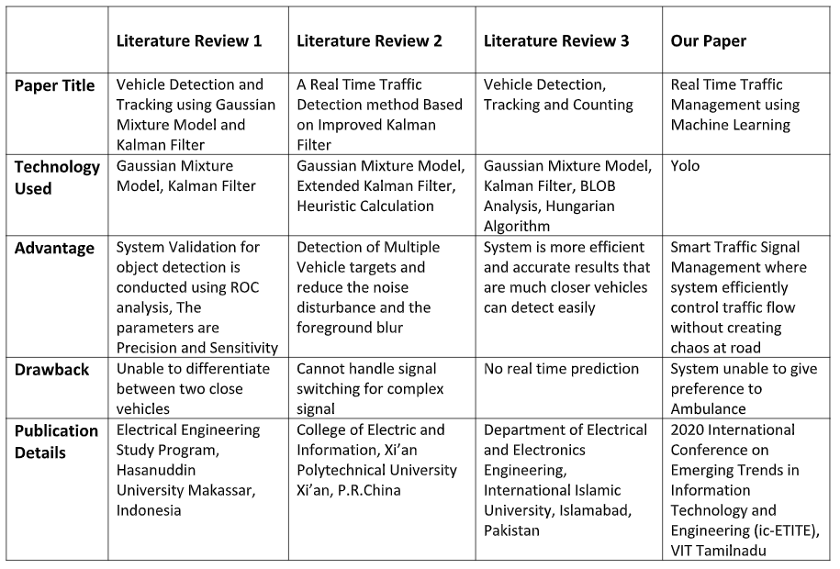
1.3 Overview of referred papers

Slide 10
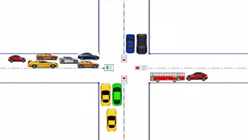
1.4 Problem Definition
The management of traffic by traditional approach is not efficient for smooth commutation purpose, hence there was a need to come up with a solution which can be globally accepted and would lead for the better management of traffic.
To design a system which learns from the surrounding, makes prediction and on the basis of these predictions the signal switching will be done so as to ensure minimal vehicular congestion at traffic signal.

Slide 11
1.5 Scope
The project aims to monitor signal and makes decisions taking real time traffic scenarios into consideration, thus signal switching will be done in a smart and efficient way.
Traffic Congestion problems at various places will decrease.
Automatic traffic controlling without human intervention.
Improve safety on the road network.
This project can also be implemented on multiple signals.

Slide 12
1.6 Technology stack
Pi camera
Servo/stepper motor
YOLO
OpenCV
& Python
Raspberry Pi

Slide 13
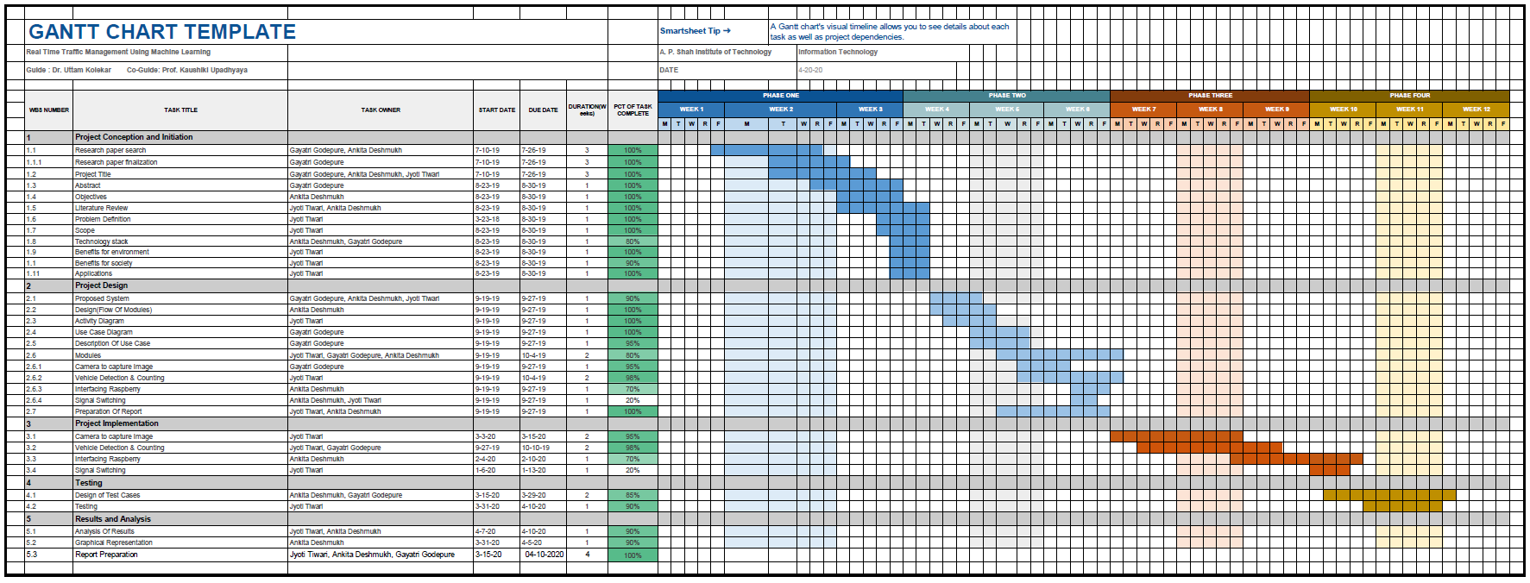
1.7 Project Timeline Chart

Slide 14
1.8 Benefits for environment & Society
Minimise vehicular emission on the road.
Current traffic condition can be analysed to understand the cause of traffic jam and accordingly action required can be taken to reduce jam at signals.
If traffic is managed in an efficient way then amount of noise and chaos created at signals can be reduced.
Time saving process where in individuals would not have to wait for signal to turn green after some predefined interval.
No human interaction required for signal switching and signal can be observed from any remote location.

Slide 15
2. Project Design

Slide 16
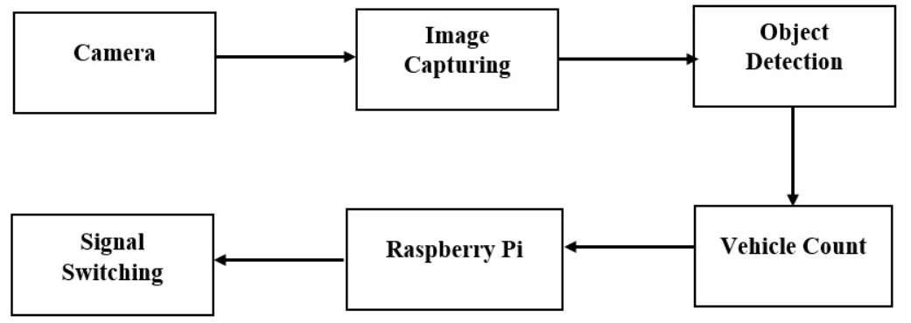
2.1 Proposed System
The image is captured using pi camera and is passed to the model for vehicle detection purpose followed by vehicle counting.
After the object gets detected it forms a rectangular box around the object.
The count obtained from the image obtained from all for side of the road is now passed as input to the raspberry board.
The board calculate the switching time required for signal by comparing the count obtained with the threshold value.
Block diagram of proposed system

Slide 17
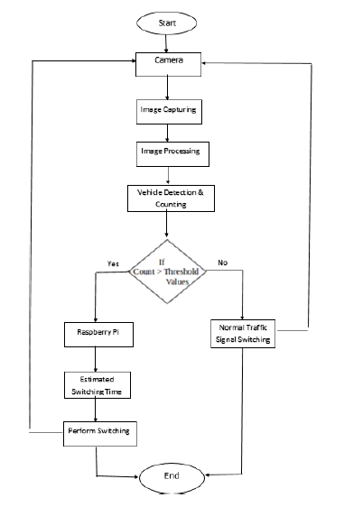
2.2 Design(Flow Of Modules)
The project flow is divided into of sequence of activity following one after the another starting from capturing the images at the traffic signals, applying image detection algorithms to detect the vehicles, comparing the count with threshold and finally passing the count to the raspberry board to perform switching.
To make this model working the project is divided into three main sub modules starting from Camera module followed by YOLO module and Raspberry Pi module.

Slide 18
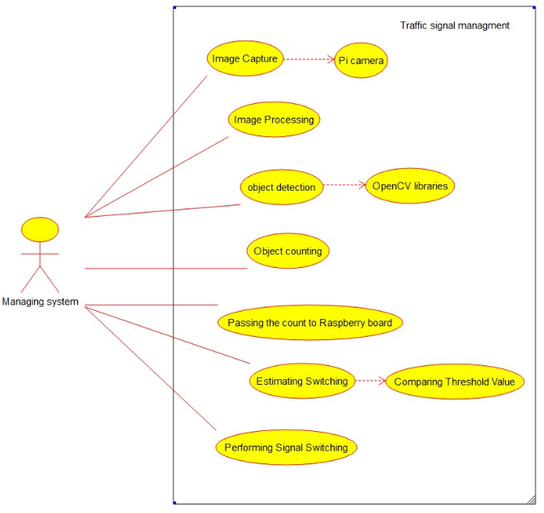
2.3 Description Of Use Case
The managing system is nothing but the
trained model, it has access all over the modules.
The model captures image using pi camera and
provide count to raspberry.
The raspberry board compares the count
with threshold value and computes the
switching time for the signals.

Slide 19
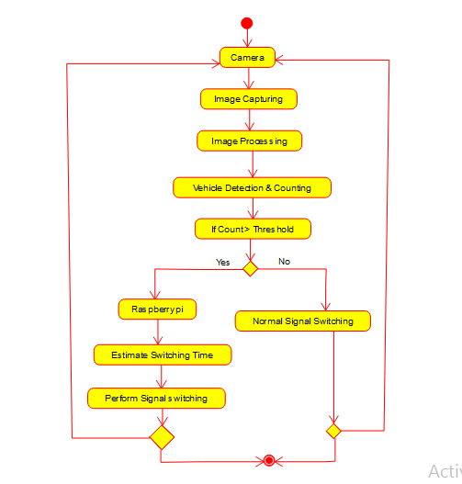
2.4 Activity diagram

Slide 20
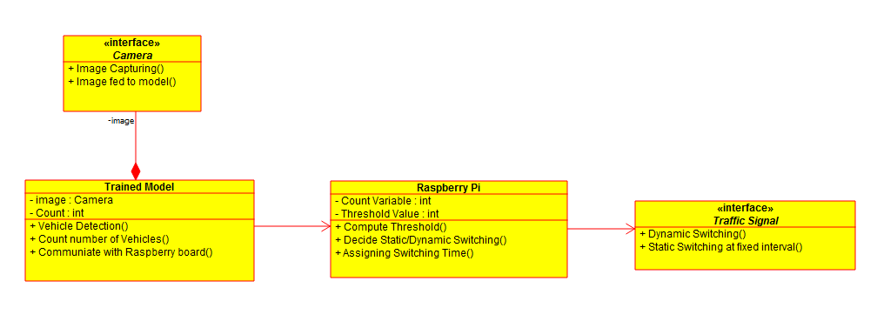
2.5 Class Diagram

Slide 21
2.6 Module-1
Camera Module:
Camera module used in this system is a pi camera, because of its compatibility and less interfacing with the raspberry board required to make connection.
One single camera module is fitted on the top of servo/stepper motor so that it can rotate 360 degree and capture image of all sides of road.
The motor's rotational speed is adjusted in a way that it gives clear images and rotates continuously to capture image.
The image captured by the camera is then passed to the next module i.e. server machine to perform detection.
Hence, the task of the camera is to capture images constantly at an fixed interval and pass the images to server by forming a socket between client and server.
The connection between client and server is done by creating a socket and binding the machines with particular ip address. Thus both client and server machine are binded with some specific ip and ports which remains unique.

Slide 22
Module-2
YOLO Module:
The image captured from camera module is constantly send to object detection module i.e. from client to server machine.
Image is captured in client OS i.e. in Raspbian OS which is passed to the host system since the host system has more computational power when compared to client's system.
Further task of vehicle detection and counting is performed on host side and count of vehicle is obtained, this count is then passed to raspberry board to perform the task of switching.
YOLO is one of the most powerful pretrained and is a combined version of R-CNN and SSD, it performs the task of vehicle detection and extract the count of vehicles.
R-CNN uses selective search algorithm and proposes accurate bounding box that definitely contains objects and SSD that helps is speed processing of an image
It divides the image in to M x M grid and calculate confidence and threshold value.
Confidence score is the score that tells us whether object is present or not.
YOLO computes its prediction in terms of precision and recall, precision measures how accurate is your predictions and recall measures how good you find all the positives.

Slide 23
Module-3
Raspberry Pi Board:
The output given by the model is provided as input to the board i.e. the count value.
The board compares the count obtained from all four sides of the road, after that it computes the difference in count with respect to each other lanes and cross check with the threshold value set manually in the model.
If difference in vehicle count is less than threshold value then normal switching at predefined regular interval is performed else the raspberry board will to compute and decide different switching time for all signals.
The switching time decided by the board is then passed to the led and accordingly the led glows for all lanes i.e. either green, red or yellow.
This process is executed in continuous loop so that every lane's led turns to green atleast once in every cycle for minimum number of seconds.

Slide 24
2.7 References
Indrabayu, Rizki Yusliana Bakti, Intan Sari Areni, A. Ais Prayogi “Vehicle Detection and Tracking using Gaussian Mixture Model and Kalman Filter”, 2016 International Conference on Computational Intelligence and Cybernetics Makassar, Indonesia , 22-24 November 2016
R. Krishnamoorthy, Sethu Manickam “Automated Traffic Monitoring Using Image Vision”,The 2nd International Conference on Inventive Communication and Computational Technologies (ICICCT 2018) Coimbatore , India , 20-21 April 2018
Joseph Redmon, “YOLOv3: An Incremental Improvement” Ali Farhadi University of Washington
Sayan Mondal, Alan Yessenbayev, Jahya Burke, Nihar Wahal, “A Survey of Information Acquisition in Neural Object Detection Systems”, 32nd Conference on Neural Information Processing Systems (NeurIPS 2018), Montréal, Canada.

Slide 25
References
Li Xun, Nan Kaikai, Liu Yao, Zuo Tao “A Real-Time Traffic Detection Method Based on Improved Kalman Filter”, 2018 3rd International Conference on Robotics and Automation Engineering (ICRAE) Guangzhou, China, 17-19 November 2018
Safoora Maqbool, Mehwish Khan, Jawaria -Tahir, Abdul Jalil, Ahmad Ali, Javed Ahmad Vehicle Detection, Tracking and Counting” 2018 IEEE 3rd International Conference on Signal and Image Processing (ICSIP) Shenzhen, China, 13-15 July 2018
Jess Tyron G. Nodado, Hans Christian P. Morales, Ma Angelica P. Abugan, Jerick L. Olisea, Angelo C. Aralar, Pocholo James M. Loresco “Intelligent Traffic Light System Using Computer Vision with Android Monitoring and Control”, Proceedings of TENCON 2018 - 2018 IEEE Region 10 Conference Jeju

Slide 26
3.Future scope

Slide 27
Future scope
In case of an ambulance stuck in traffic, prior information will be available at signal and accordingly the particular lane will be made free so that ambulance can pass easily even from highly congested areas.
Also the aim is to perform pothole detection and report the quality of road to the administration regularly at predefined interval.

Slide 28
Thank You

